Slide 1
LEX AND YACC

Slide 2
sudo apt-get update
sudo apt-get -f install flex
sudo apt-get install bison

Slide 3
FLEX (fast lexical analyzer generator) is a tool/computer program for generating lexical analyzers (scanners or lexers) written by Vern Paxson in C around 1987.
It is used together with Berkeley Yacc parser generator or GNU Bison parser generator.
Flex and Bison both are more flexible than Lex and Yacc and produces faster code.

Slide 4
Bison produces parser from the input file provided by the user.
The function yylex() is automatically generated by the flex when it is provided with a .l file
yylex() function is expected by parser to call to retrieve tokens from current/this token stream.

Slide 5
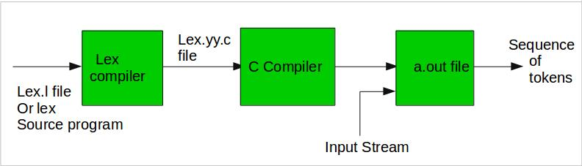

Slide 6
How to run the program:
To run the program, it should be first saved with the extension .l or .lex. Run the below commands on terminal in order to run the program file.
Step 1: lex filename.l or lex filename.lex depending on the extension file is saved with
Step 2: gcc lex.yy.c
Step 3: ./a.out
Step 4: Provide the input to program in case it is required

Slide 7
Program Structure:
In the input file, there are 3 sections:
1. Definition Section: The definition section contains the declaration of variables, regular definitions, manifest constants.
In the definition section, text is enclosed in “%{ %}” brackets. Anything written in this brackets is copied directly to the file lex.yy.c
Syntax:
%{
// Definitions
%}

Slide 8
Rules Section: The rules section contains a series of rules in the form: pattern action
pattern must be unintended
action begin on the same line in {} brackets.
The rule section is enclosed in “%% %%”.
Syntax:
%%
pattern action
%%

Slide 9
Pattern It can match with
[0-9] all the digits between 0 and 9
[^a] all the other characters except a

Slide 10
User Code Section: This section contain C statements and additional functions. We can also compile these functions separately and load with the lexical analyzer.
Basic Program Structure:
%{
// Definitions
%}
%%
Rules
%%
User code section

Slide 11
Compiling YACC Program:
Write lex program in a file file.l and yacc in a file file.y
Open Terminal and Navigate to the Directory where you have saved the files.
lex file.l
yacc file.y
cc lex.yy.c y.tab.h -ll
./a.out

Slide 12
lex file.l
yacc file.y
cc lex.yy.c y.tab.h -ll
./a.out

